Slide 1
Data Science 4/18-4/19
Finn Watson

Slide 2
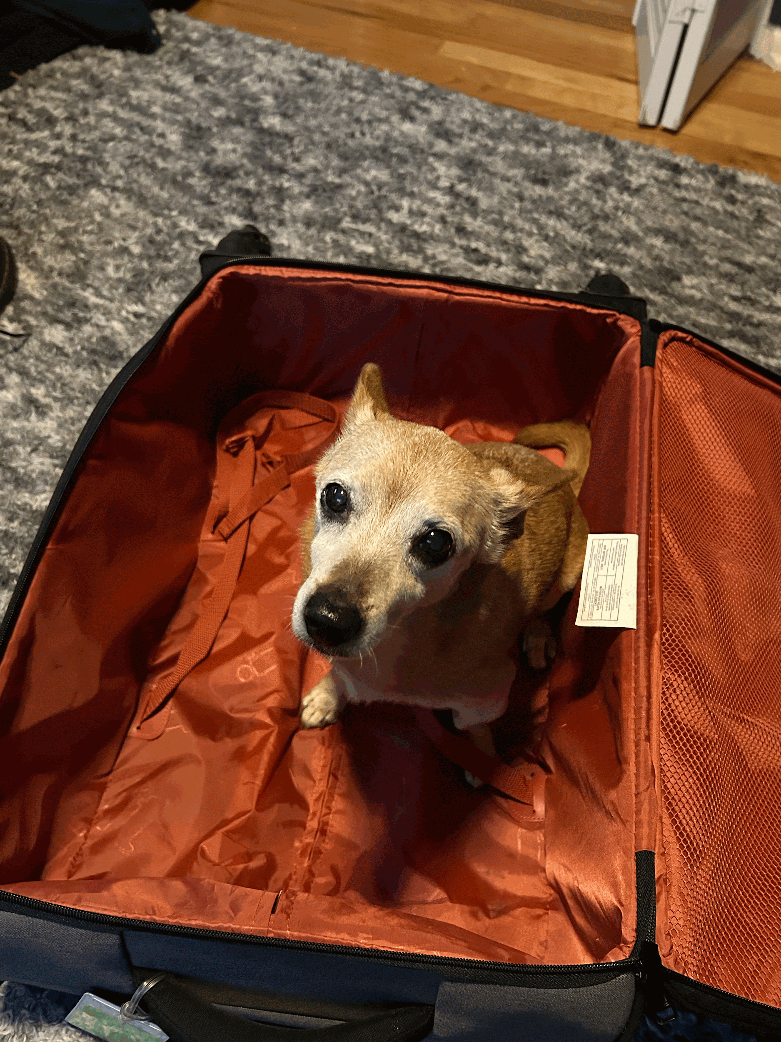

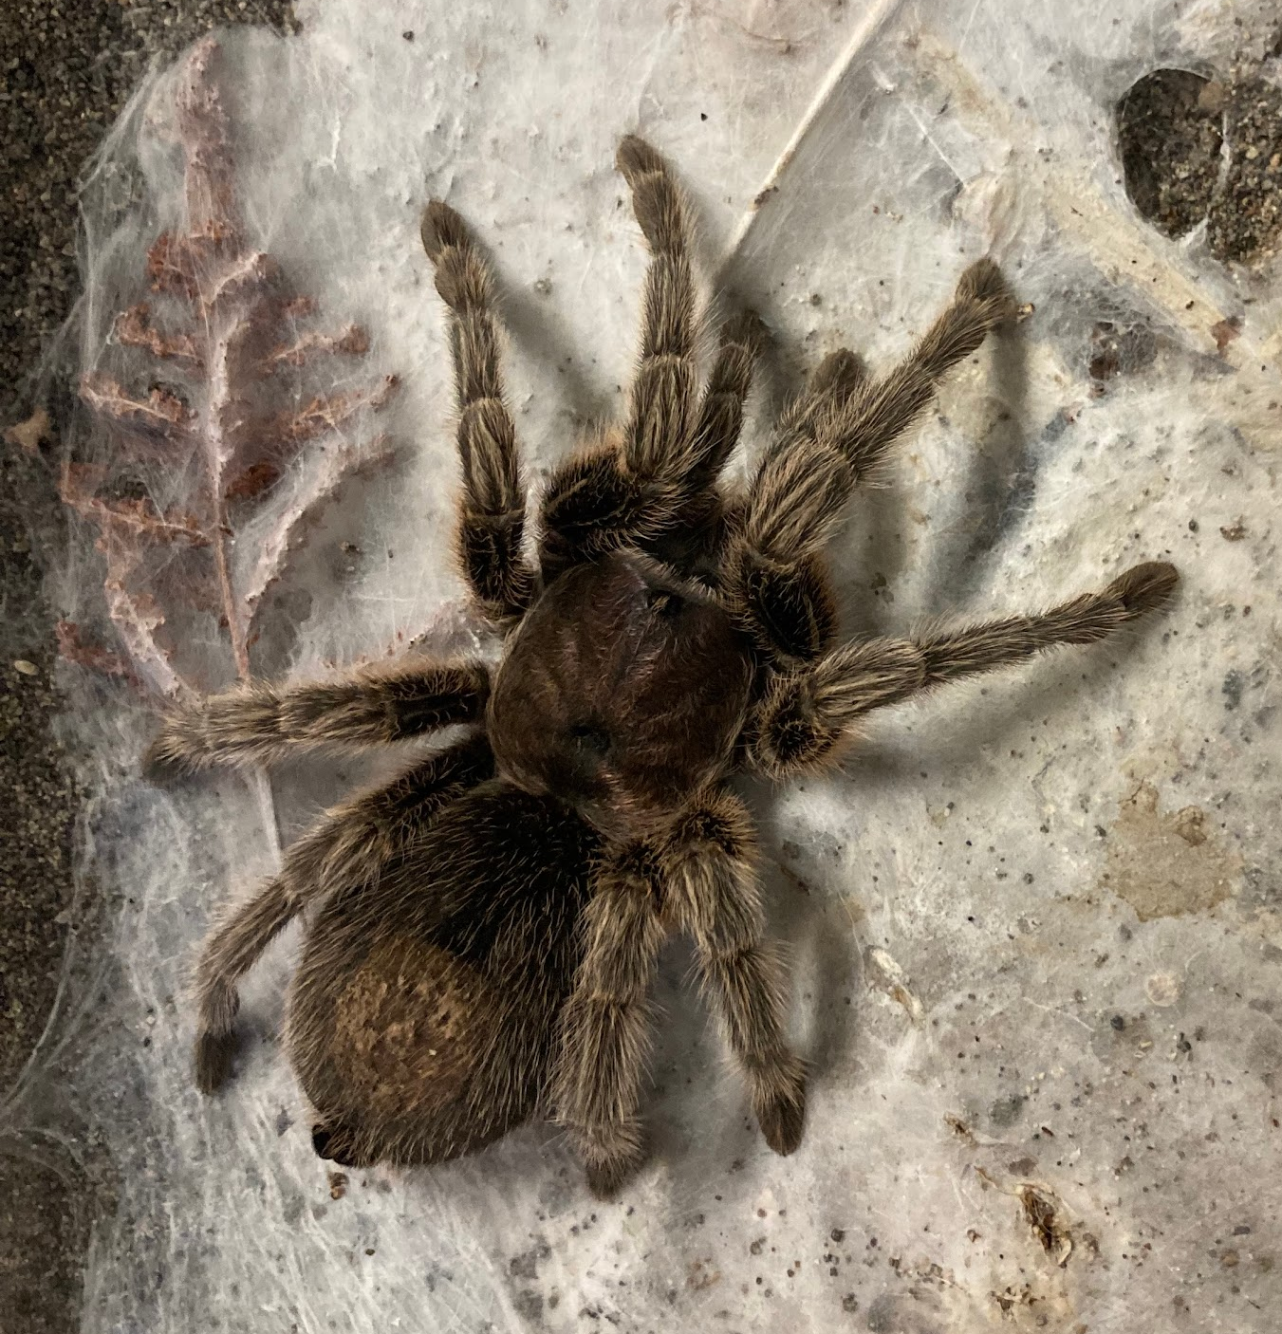
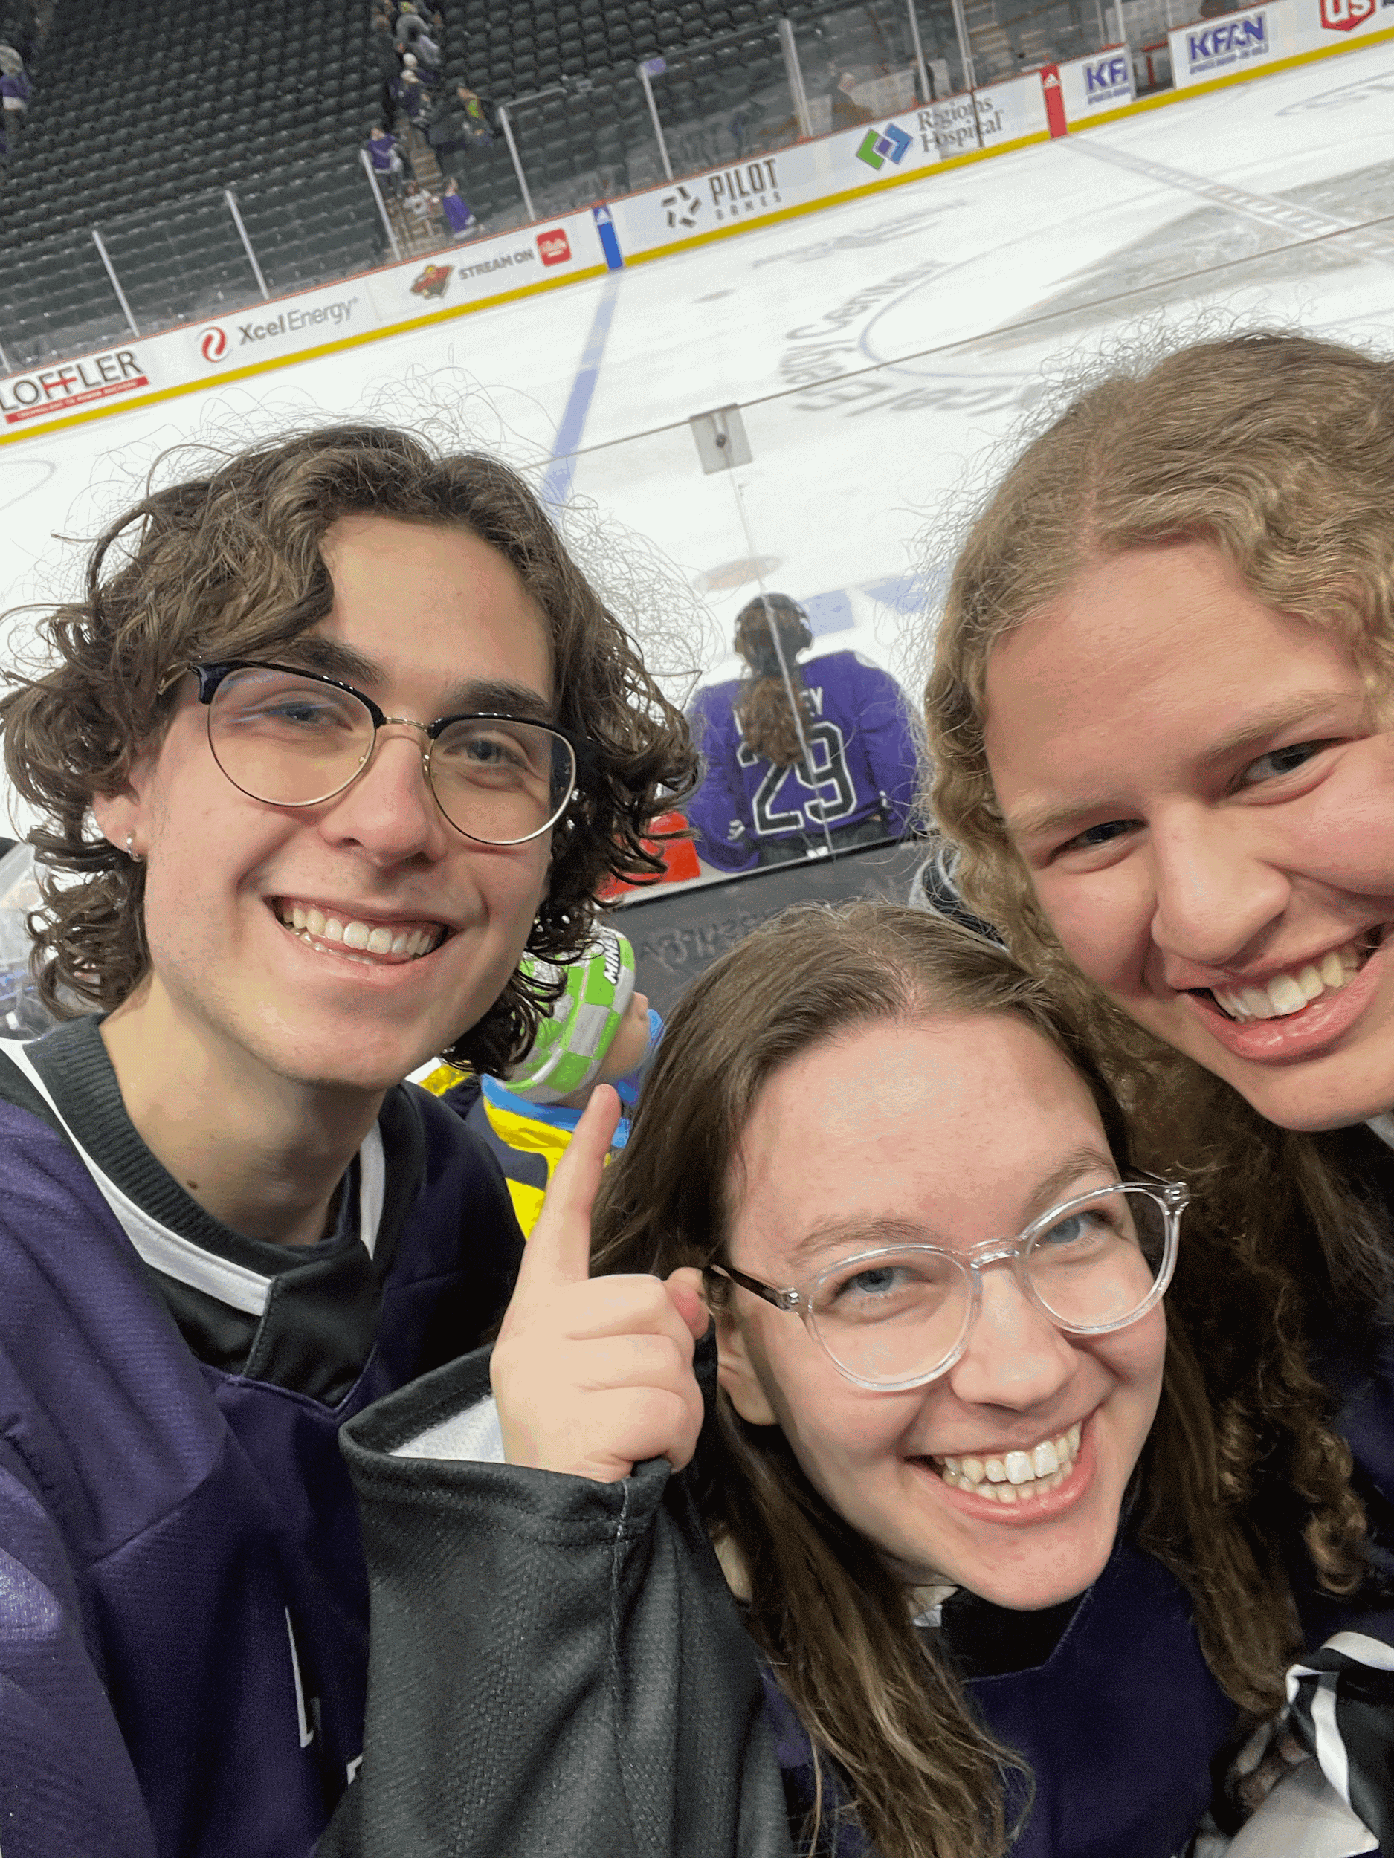
Who Am I??
Tito <3I

Slide 3

Temperature Check!
How much do you already know about data science or coding?
None
A Little
I’m A Pro

Slide 4
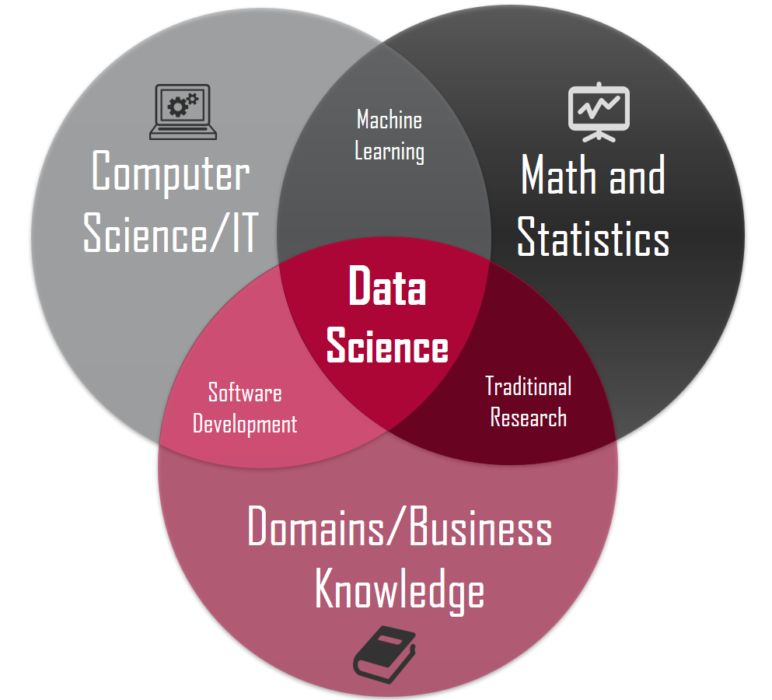
What is data science?
Notes:
The intersection of all sorts of different techniques to extract information from data! We use code, math and more to get to the heart of patterns in our data

Slide 5
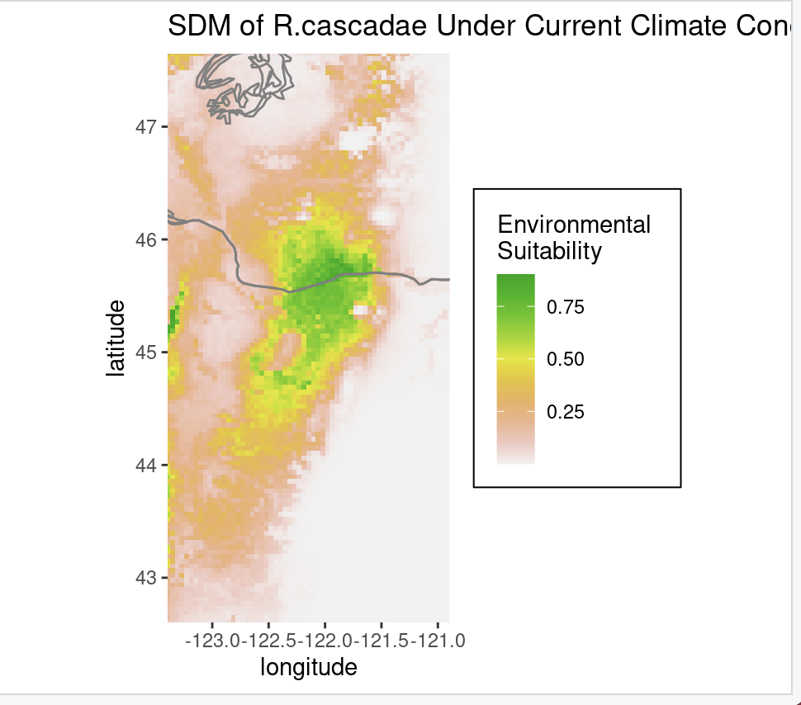
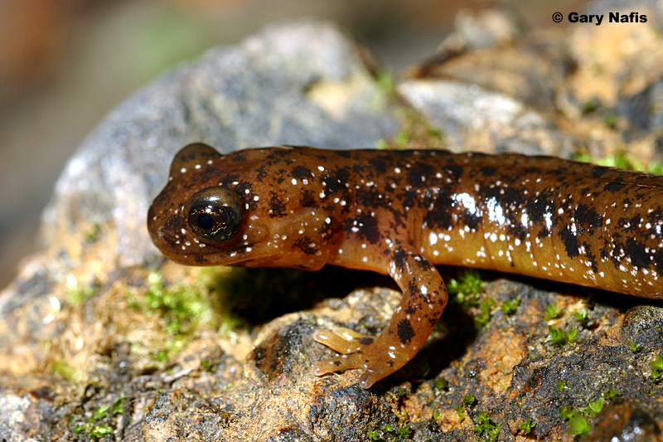
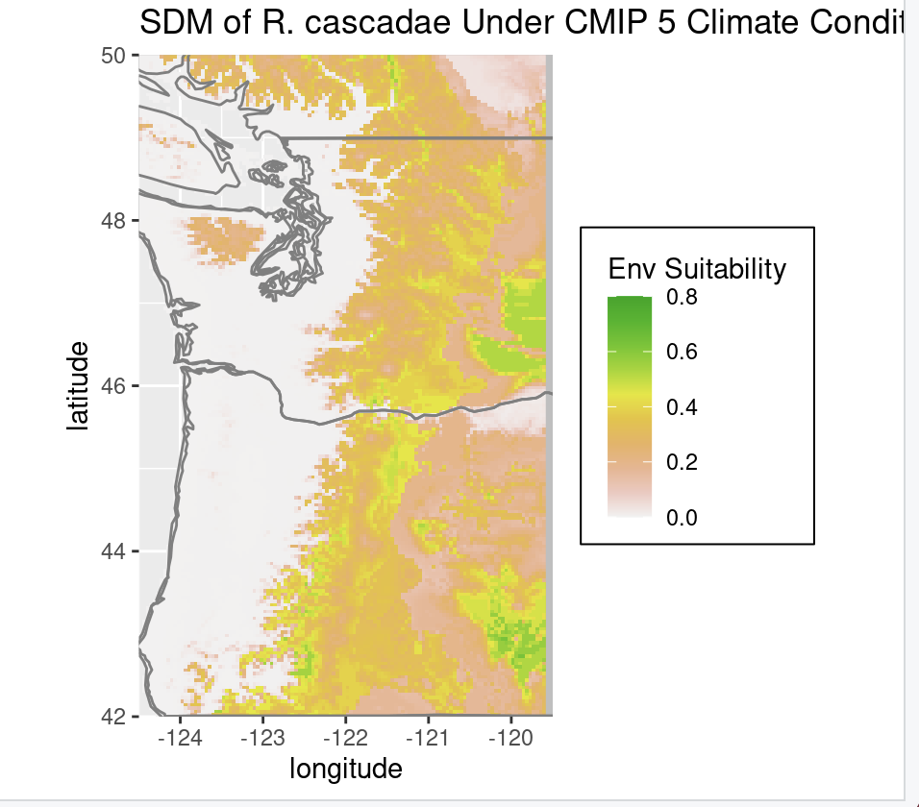
Data Science In Real Life!

Slide 6
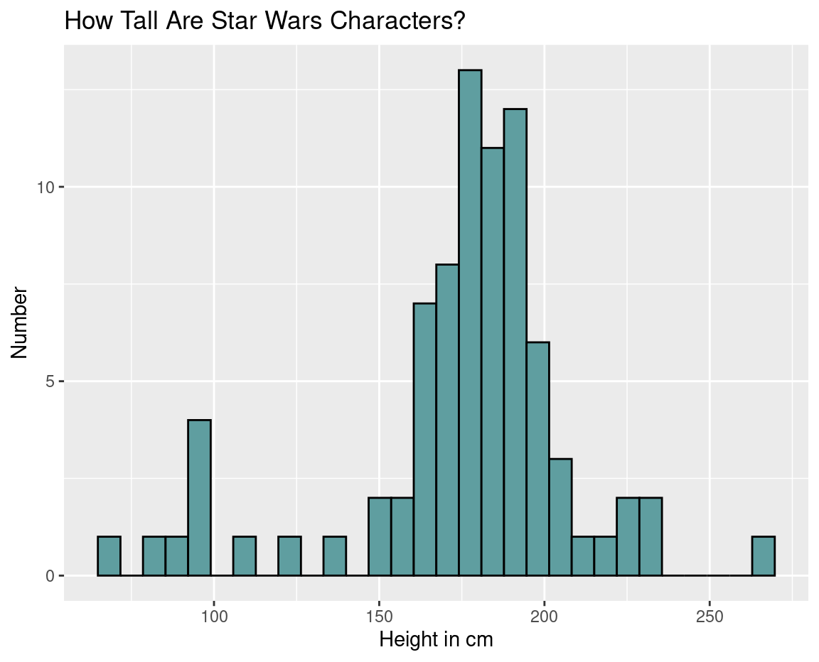
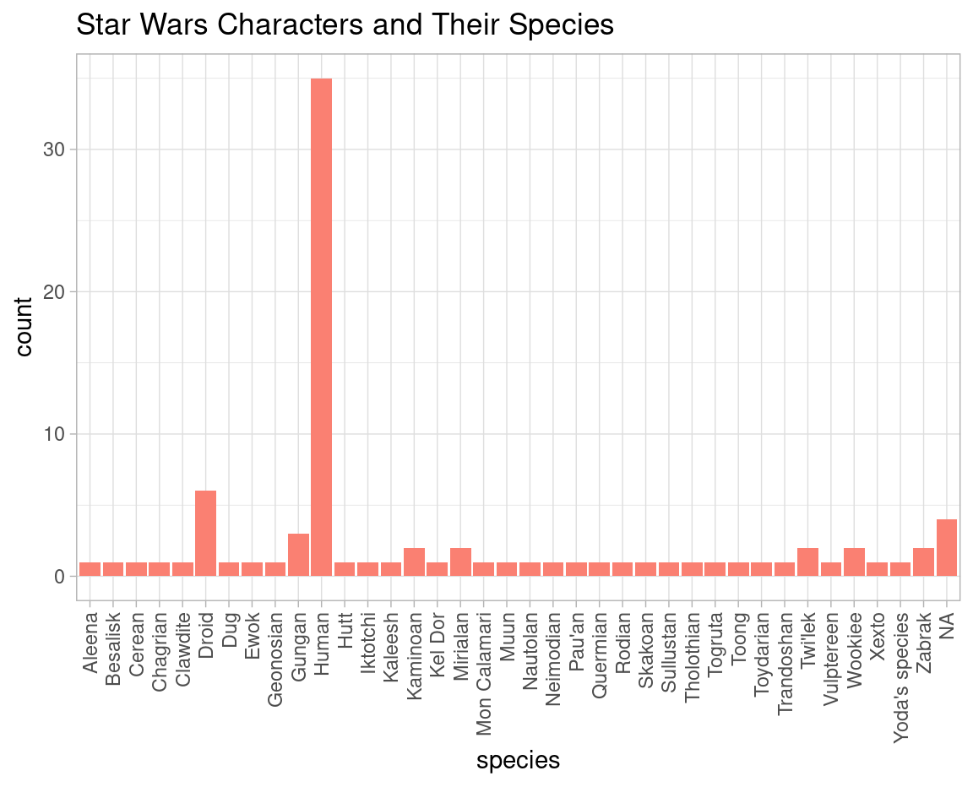
Data Science In Space!

Slide 7
Can you think of times data science might be useful?

Slide 8
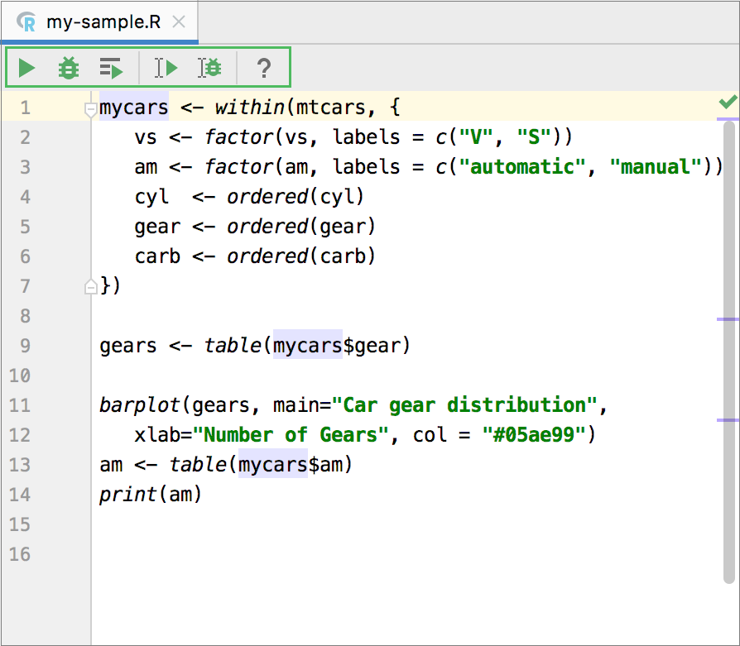
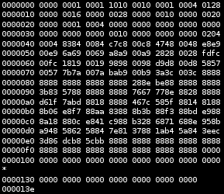

Computer Coding
Computers are super literal
We can’t actually speak the same language computers speak
Instead use special kinds of language that gets translated to tell them what to do

Slide 9
Demo Time :)
Interactive Tutorial

